Slide 1
Natural Language Processing
Lecture 16—CSCI 5832
Jim Martin

Slide 2
Today
Dynamic programming for CFG parsing
CKY Parsing
Chapter 11
Probabilistic CKY
Chapter 12

Slide 3
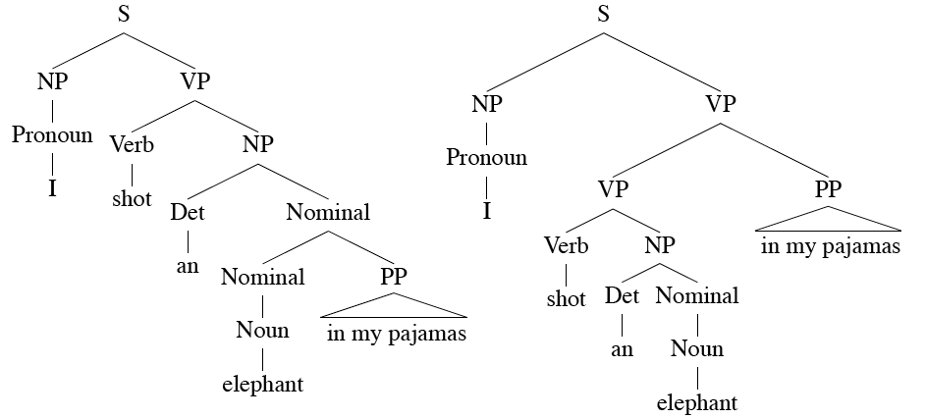
Problem: Ambiguity

Slide 4
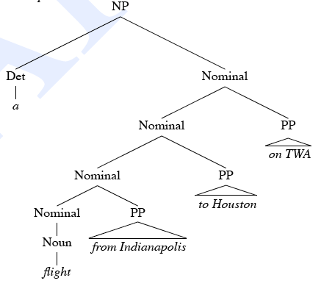
Problem: Shared Sub-Problems
Consider
A flight from Indianapolis to Houston on TWA

Slide 5
CKY Parsing
First we’ll limit our grammar to epsilon-free, binary rules (more on this later)
Consider the rule A → BC
If there is an A somewhere in the input governed by this rule then there must be a constituent B followed by a C in the input.
If the A spans from i to j in the input then there must be some k st. i<k<j
In other words, the B splits from the C someplace after the i and before the j. Call that place k.

Slide 6
CKY
So, let’s build a table so that an A spanning from i to j in the input is represented in cell [i,j] in the table.
So a non-terminal spanning an entire input sequence will sit in cell [0, n]
Hopefully it will be an S
And the entries in [0,1], [1,2], etc. correspond to the words in the input.

Slide 7
CKY
Book the flight through Houston

Slide 8
CKY
₀ Book ₁ the ₂ flight ₃ through ₄ Houston ₅
For example
Cell[2,5] “flight through Houston”
Cell [1,2] “the”
Cell [2,4]

Slide 9
CKY
We know that the parts of a non-terminal A in [i,j] must go from i to k and from k to j, for some k
Meaning that for a rule like A → B C we need a B in [i,k] and a C in [k,j].
In other words, for cell[i,j]
If A → B C is a rule in the grammar and
There’s a B in [i,k] and a C in [k,j] for some k such that i<k<j
Then we’re allowed to put an A in cell[i,j]

Slide 10
CKY
So to fill the cells in any dynamic programming table, we loop over the cells [i,j] values in some systematic way
For each cell, loop over the appropriate k values to search for things to add.
Add all the derivations that are possible
for each [i,j] for each k

Slide 11
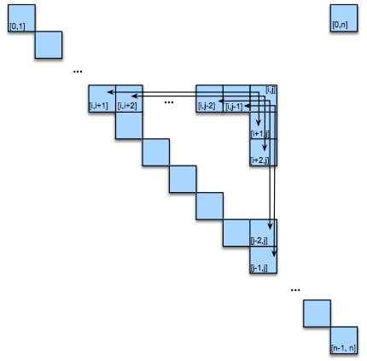
CKY Table

Slide 12
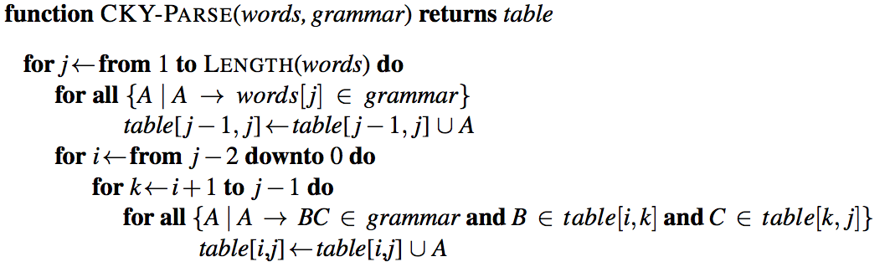
CKY Algorithm
Looping over the columns
Filling the bottom cell (POS tags)
Filling row i in column j
Looping over the possible split locations between i and j.
Check the grammar for rules that link the constituents in [i,k] with those in [k,j]. For each rule found store the LHS of the rule in cell [i,j].

Slide 13
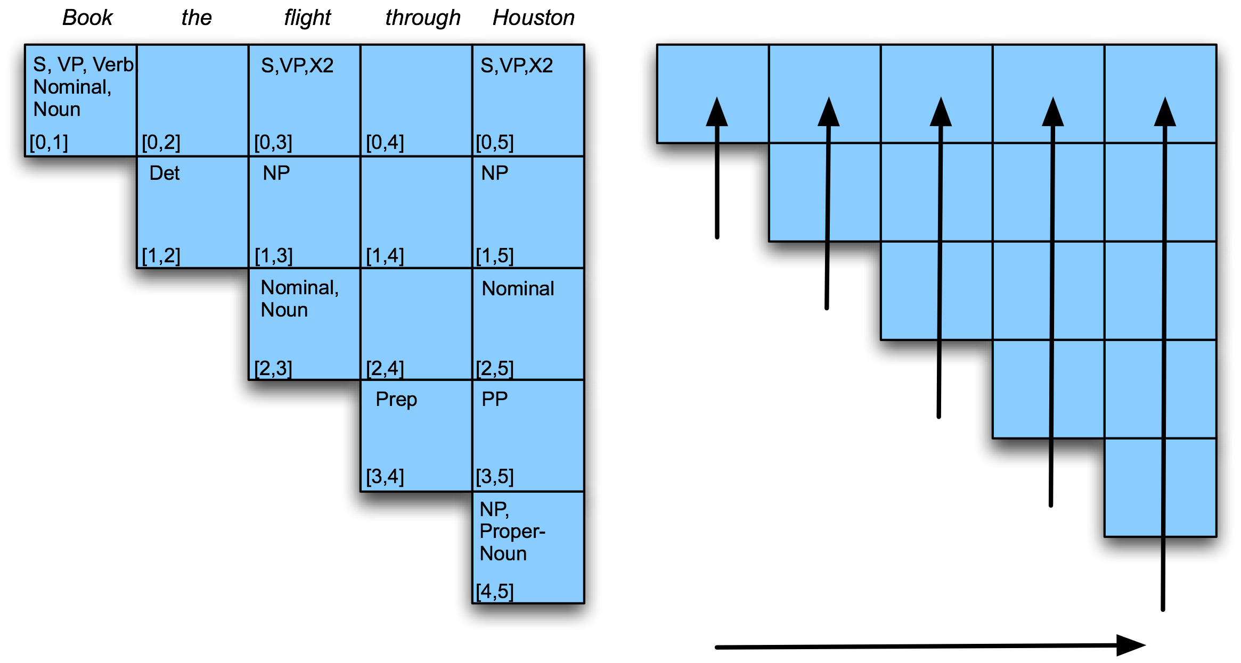
Example

Slide 14
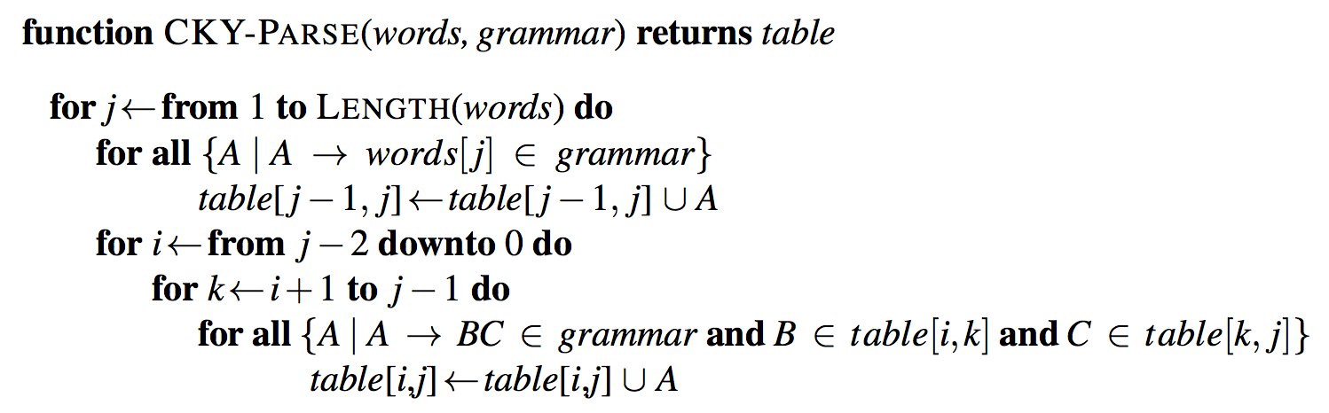
Example
Filling column 5 corresponds to processing word 5, which is Houston.
So j is 5.
So i goes from 3 to 0 (3,2,1,0)

Slide 15
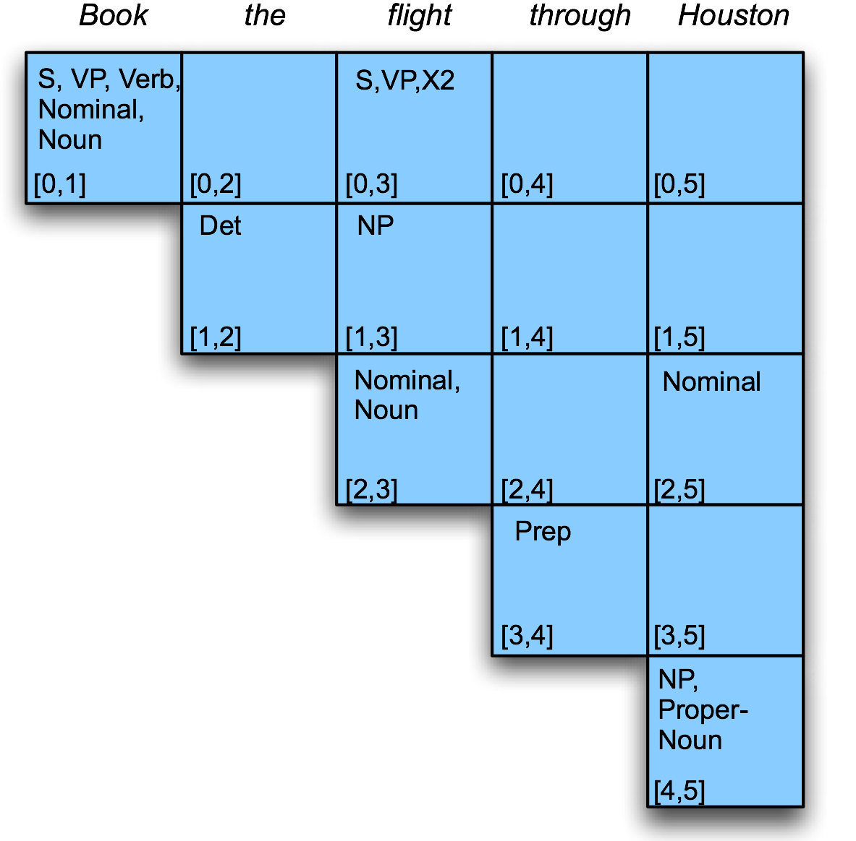
Example
Filling column 5

Slide 16
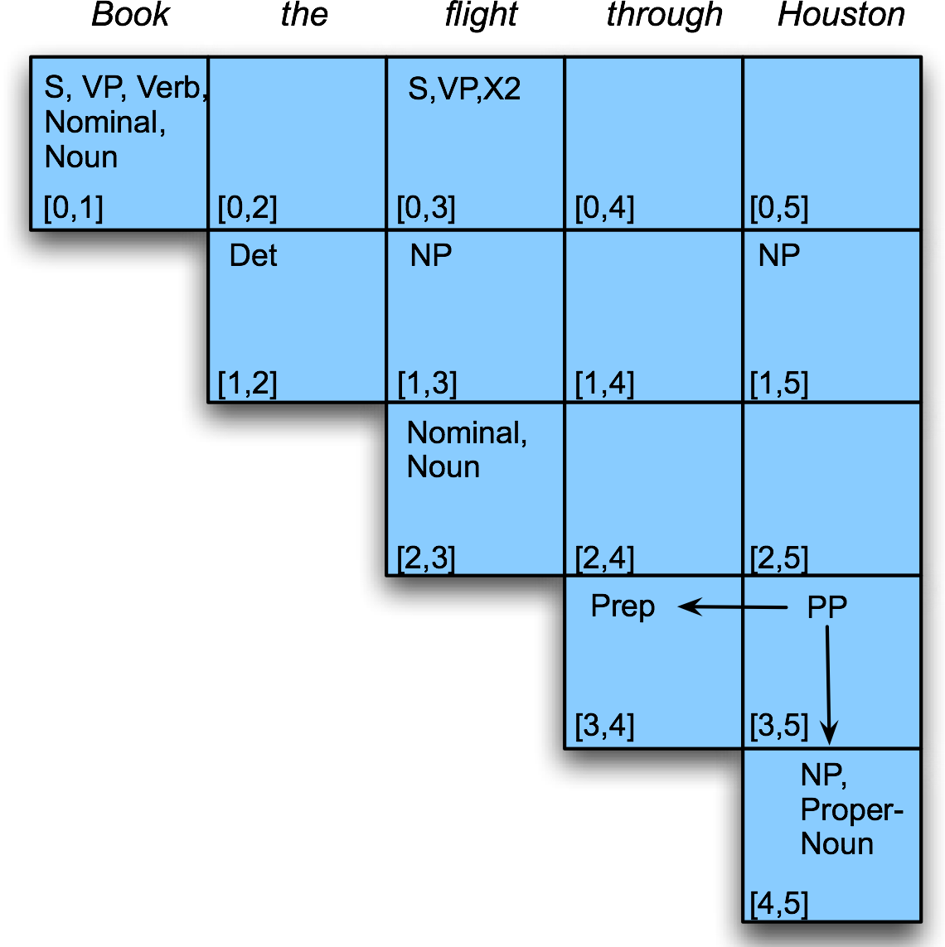
Example

Slide 17
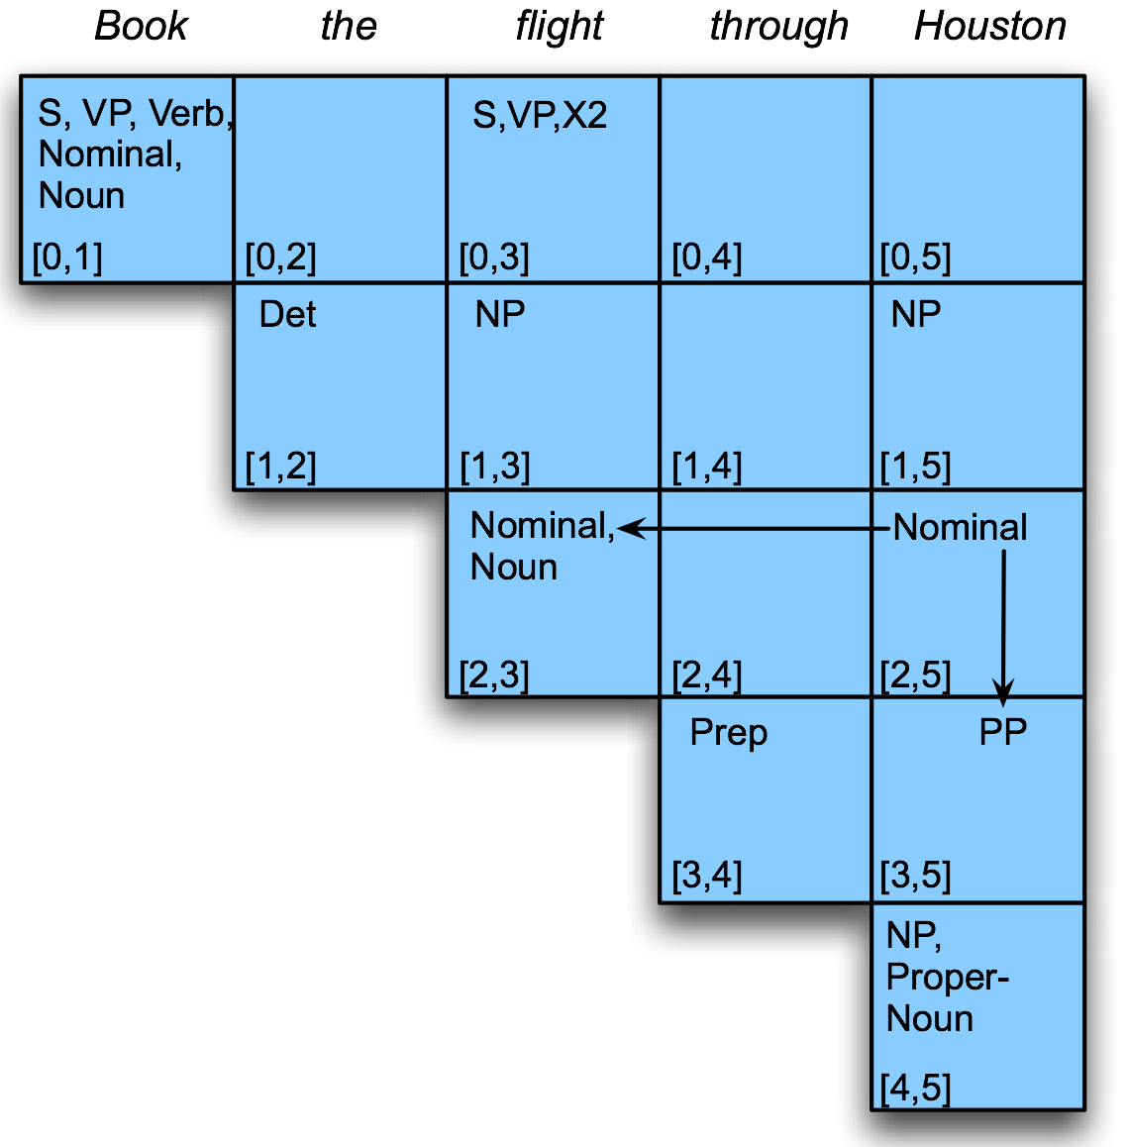
Example

Slide 18
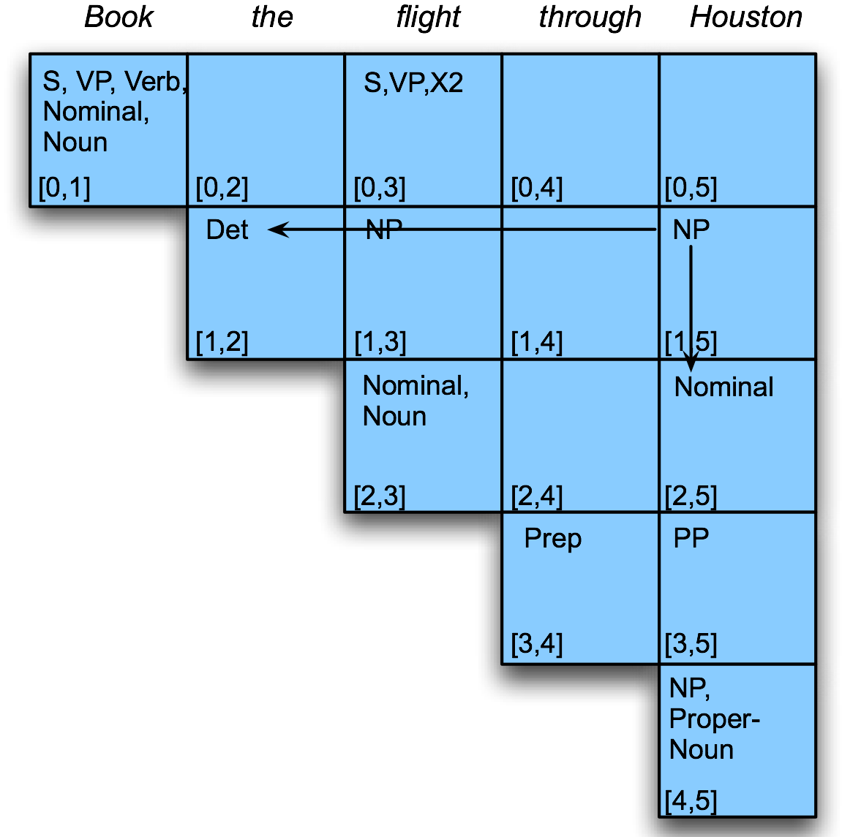
Example

Slide 19
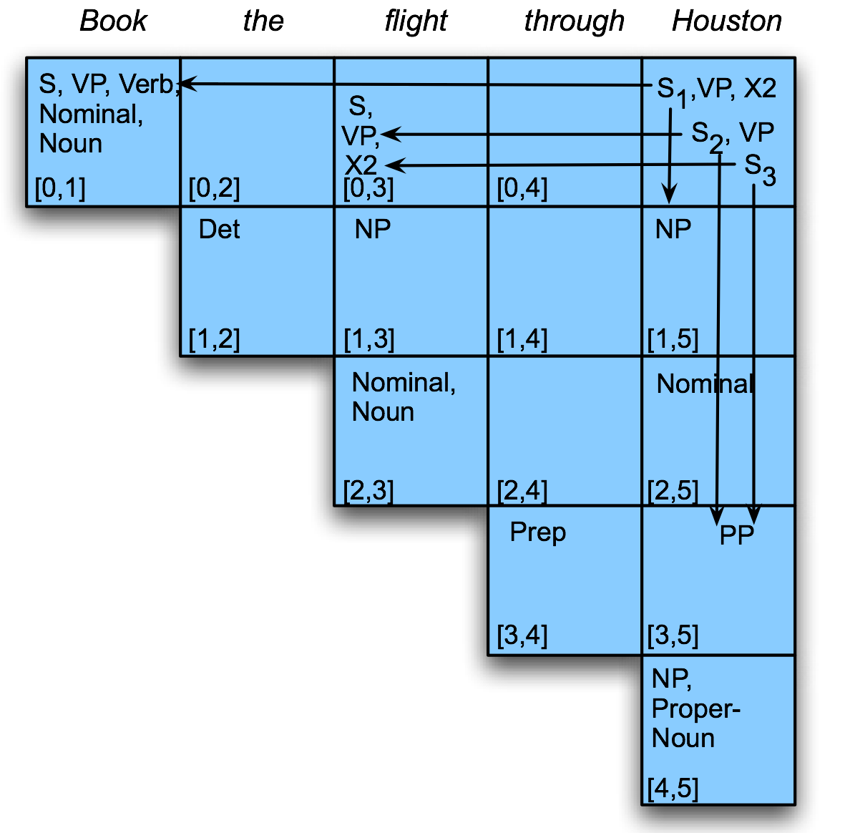
Example

Slide 20
Example
Since there’s an S in [0,5], we have a valid parse.
Are we done? We we sort of left something out of the algorithm

Slide 21
CKY Notes
Since it’s bottom up, CKY hallucinates a lot of useless constituents.
Segments that by themselves are constituents but cannot really occur in the context in which they are being suggested.

Slide 22
CKY Notes
We arranged the loops to fill the table a column at a time, from left to right, bottom to top.
This assures us that whenever we’re filling a cell, the parts needed to fill it are already in the table (to the left and below)
It’s somewhat natural in that it processes the input a left to right a word at a time
Known as online processing
Can you think of an alternative strategy?

Slide 23
Note
An alternative is to fill a diagonal at a time.
That still satisfies our requirement that the component parts of each constituent/cell will already be available when it is filled in.
What’s another way to describe filling a diagonal at a time?

Slide 24
Getting the Right Parse
CKY ends with a table packed with all the possible parses (anchored by an S in [0,n])
It can not select the “right” parse out of all the possible parses
Even if we knew what “right means”
If we interpret “right” to mean “most probable” parse” we get our old friend
Argmax P(Parse|Words)

Slide 25
Probabilistic CFGs
1 The framework (Model)
How to define the probability of a parse tree
2 Training the model (Learning)
How to acquire estimates for the probabilities specified by the model
3 Parsing with probabilities (Decoding)
Given an input sentence and a model how can we efficiently find the best (or N best) tree(s) for that input

Slide 26
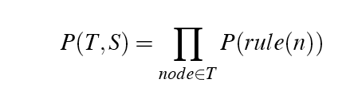
Simple Probability Model
A derivation (tree) consists of the bag of grammar rules that make up the tree
The probability of a tree is the product of the probabilities of the rules in the derivation.

Slide 27
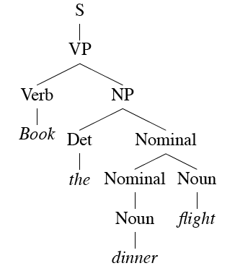
Example
How many rules are in this derivation?

Slide 28
Rule Probabilities
So... What’s the probability of a rule?
Start at the top...
A tree should have an S at the top. So given that we know we need an S, we can ask about the probability of each particular S_{n} rule in the grammar.
That is P(Rule S_{n} | S is what I need)
So in general we need
For each rule in the grammar

Slide 29
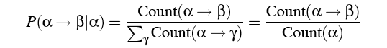
Training the Model
We can get the estimates (MLE) we need from an annotated corpus (i.e., a treebank)
S, to get the probability for a particular VP rule, just count all the times that rule is used and divide by the number of VP’s overall.

Slide 30
Parsing (Decoding)
To get the best (most probable) parse for a given input
Enumerate all the trees for a sentence
Assign a probability to each using the model
Return the best (argmax)

Slide 31
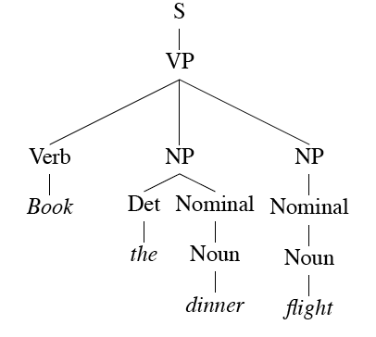
Example
Consider...
Book the dinner flight

Slide 32
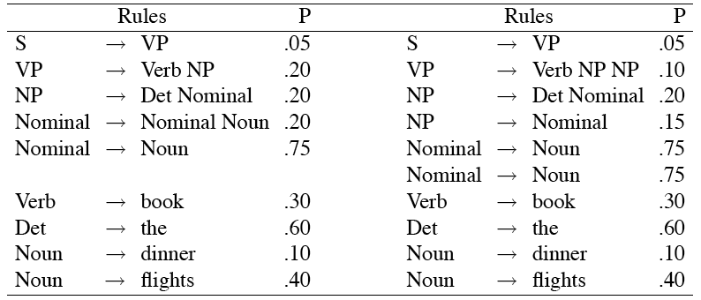
Examples
These trees consist of the following rules.

Slide 33
Dynamic Programming
Of course, as with earlier argmax situations, we don’t really want to do it that way.
Instead, we need to exploit dynamic programming
For the parsing (as with CKY)
And for computing the probabilities and returning the best parse (as with Viterbi)

Slide 34
Probabilistic CKY
Augment CKY so that the probabilities of the constituents are stored in the table as they are derived
Probability of a new constituent A derived from the rule A → B C :
P(A → B C | A) * P(B) * P(C)
Where P(B) and P(C) are already in the table given the way that CKY operates
What we store is the MAX probability over all the A rules for a given cell [i,j]

Slide 35
CKY Algorithm
Looping over the columns
Filling the bottom cell (POS tags)
Filling row i in column j
Looping over the possible split locations between i and j.
Check the grammar for rules that link the constituents in [i,k] with those in [k,j]. For each rule found store the LHS of the rule in cell [i,j].

Slide 36
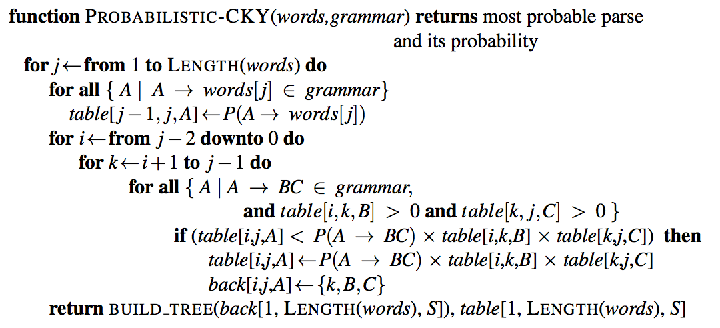
Probabilistic CKY
Prob of word as a particular POS
Max for a given constituent
Argmax S

Slide 37
Problems with PCFGs
The probability model we’re using is just based on the the bag of rules in the derivation…
Doesn’t take the actual words into account in any useful way.
Doesn’t take into account where in the derivation a rule is used
Doesn’t work terribly well
That is, the most probable parse isn’t usually the right one (the one in the treebank test set).

Slide 38
Evaluation
How do we measure how well a parser is working?
Assume we have a training/dev set from a treebank so we have “reference” answers for some set of trees.
We could look for simple accuracy across a test set of sentences
How many sentences received the exactly correct parse?

Slide 39
Evaluation
That’s too depressing
And not informative enough --- we might be making useful changes to the system and not see any improvement given this metric
The trees are getting better, but they’re still not right and hence the metric isn’t changing
A better metric analyzes the contents of both the reference tree and the hypothesis tree

Slide 40
Example
Consider...
Book the dinner flight
Parser output
Reference answer

Slide 41
Evaluation
Precision
What fraction of the sub-trees in our parse match corresponding sub-trees in the reference answer
How much of what we’re producing is right?
Recall
What fraction of the sub-trees in the reference answer did we actually get?
How much of what we should have gotten did we get?

Slide 42
Example
Consider...
Book the dinner flight
Precision: 6/10
Recall: 6/9
Parser output
Reference answer

Slide 43
Common Sources of Errors
Attachment ambiguities
PP attachment
Coordination problems

Slide 44
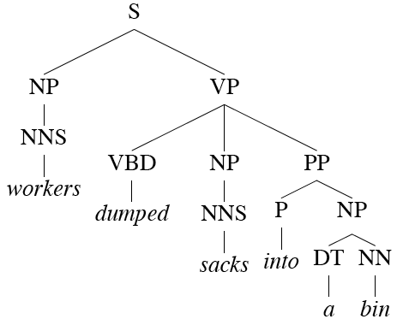
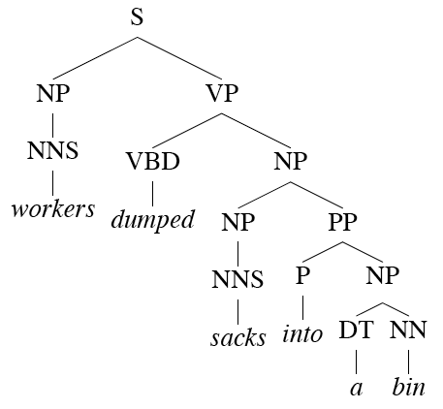
PP Attachment

Slide 45
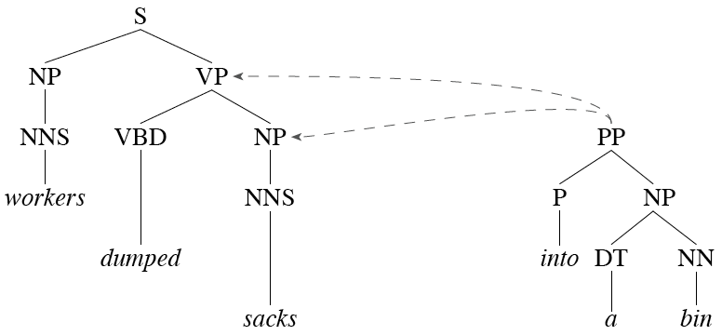
PP Attachment
Another view.

Slide 46
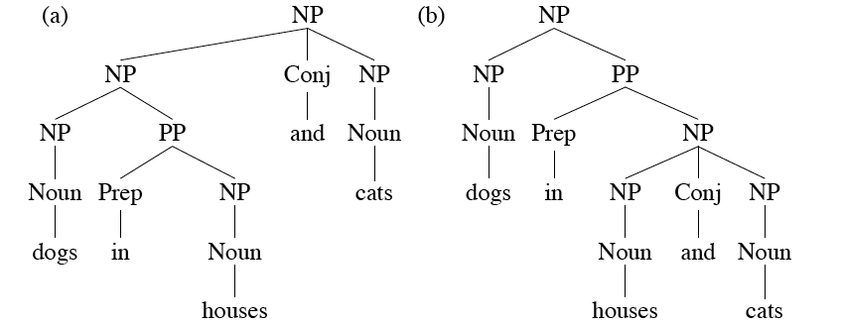
Coordination
Most grammars have a rule of the form
X -> X and X. This leads to massive ambiguity problems.

Slide 47
Improved Models
We’ll look at two approaches to overcoming these shortcomings
Rewriting the grammar to better capture the dependencies among rules
Integrate lexical dependencies into the model
And come up with the independence assumptions needed to make it work.

